Slide 1

Chapter 12
The Strategy of International Business
naqiewei/DigitalVision Vectors/Getty Images
© 2022 McGraw Hill. All rights reserved. Authorized only for instructor use in the classroom. No reproduction or further distribution permitted without the prior written consent of McGraw Hill.

Slide 2
Learning Objectives
12-1 Explain the concept of international business strategy.
12-2 Recognize how firms can increase revenue and profit by expanding globally.
12-3 Understand how pressures for cost reductions and local responsiveness influence strategic choice.
12-4 Identify the different international strategies for competing and their pros and cons.
12-5 Explain the pros and cons of using strategic alliances to support international strategies.

Slide 3
Opening Case
Geely: China’s First Global Car Company
Geely began as a refrigerator manufacturer but entered the automobile business in 19 97.
Founded by entrepreneur and car enthusiast Li Shufu.
Today, Geely is the second-largest private automobile manufacturer in China.
In 2010, Geely reached an agreement to purchase Volvo for $1.8 billion.
The marriage of Volvo’s brand and engineering design skills with Geely’s manufacturing capabilities has proved to be a winning combination.
Since the acquisition, China has emerged as a major market for Volvo cars.
In 2018, sales rose 12.4 percent to a new record high.
Notes:
Today, Volvo cars are still engineered, designed, and tested in Gothenburg, Sweden, and they still retain their Swedish character, but they are assembled at two new plants in China and a new plant in South Carolina, all built after the acquisition.
Since the acquisition, Geely and Volvo have continued to be managed as separate companies. Both Geely and Volvo are owned by Li’s investment fund, Zhejiang Geely Holding Group. However, in February 2020, Li announced that the companies were in talks to combine the two entities into a single integrated operation. If the plan is approved, the combined entity would be listed in Hong Kong and possibly Stockholm.
Sources: Pamela Ambler, “Volvo and Geely: The Unlikely Marriage of Swedish Tech and Chinese Manufacturing,” Forbes, January 23, 2018; Sui-Lee Wee, “Geely Buys Stake in Volvo Trucks,” The New York Times, December 27, 2017; “Volvo Cars Sets New Global Sales Record in 2018", Volvo Car Group, January 4, 2019; B. Gruley and J. Butler, “How China’s 36th Best Car Company Saved Volvo,” Bloomberg Businessweek, May 24, 2018; Trevor Moss, “How China’s Geely Turned a Disassembled Mercedes into a Global Car Company,” The Wall Street Journal, March 4, 2018; William Boston, “Chinese Auto Tycoon Aims to Merge Volvo and Geely,” The Wall Street Journal, February 10, 2020.

Slide 4
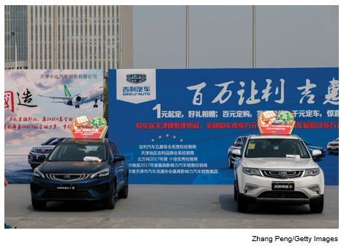
A Winning Combination
Since the acquisition, China has emerged as a major market for Volvo cars, where the brand is valued for its safety and elegance.
Notes:
China is now the largest market for the Volvo brand, with 131,000 units sold in 2018, followed by the United States, where 98,000 units were sold.

Slide 5
Introduction 1
Considerations for Managers
Benefits of expanding into foreign markets.
Which strategies to pursue in foreign markets.
Value of collaboration with global competitors.
Benefits, costs, and risks of strategic alliances.
Notes:
Strategic alliances are cooperative agreements between potential or actual competitors.

Slide 6
Strategy and the Firm 1
Strategy
The actions taken by managers to attain the goals of the firm.
Managers must pursue strategies that increase the profitability of the enterprise and its rate of profit growth over time.
Profitability: the rate of return the firm makes on its invested capital.
Profit growth: the percentage increase in net profits over time.
Notes:
LO 12-1 Explain the concept of international business strategy.
Managers can increase the profitability of the firm by pursuing strategies that lower costs or by pursuing strategies that add value to the firm’s products, which enables the firm to raise prices.
Managers can increase the rate at which the firm’s profits grow over time by pursuing strategies to sell more products in existing markets or by pursuing strategies to enter new markets.

Slide 7
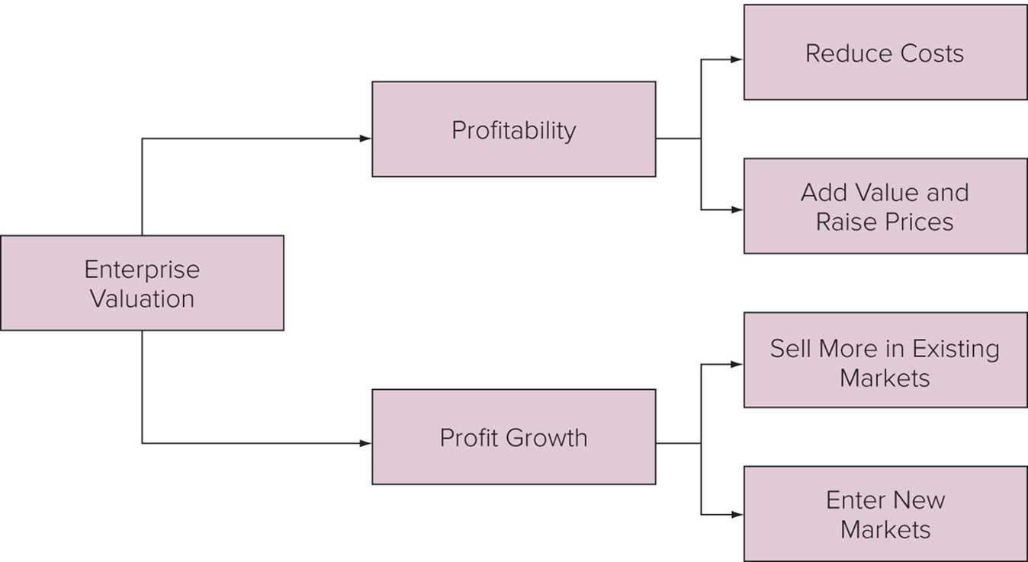
Figure 12.1 Determinants of Enterprise Value
Access the text alternative for slide images.
Notes:
To maximize the value of a firm to shareholders, managers must pursue strategies that increase the profitability of the enterprise and its rate of profit growth over time (see Figure 12.1).

Slide 8
Strategy and the Firm 2
Value Creation
Activities that increase the value of goods or services to consumers.
Measured as the difference between V (the price the firm can charge for that product given competitive pressures) and C (the costs of producing that product).
Michael Porter’s two basic strategies:
Differentiation.
Low cost.
Notes:
The way to increase the profitability of a firm is to create more value. The amount of value a firm creates is measured by the difference between its costs of production and the value that consumers perceive in its products. In general, the more value customers place on a firm’s products, the higher the price the firm can charge for those products.
This discussion suggests that a firm has high profits when it creates more value for its customers and does so at a lower cost. We refer to a strategy that focuses primarily on lowering production costs as a low-cost strategy. We refer to a strategy that focuses primarily on increasing the attractiveness of a product as a differentiation strategy.

Slide 9
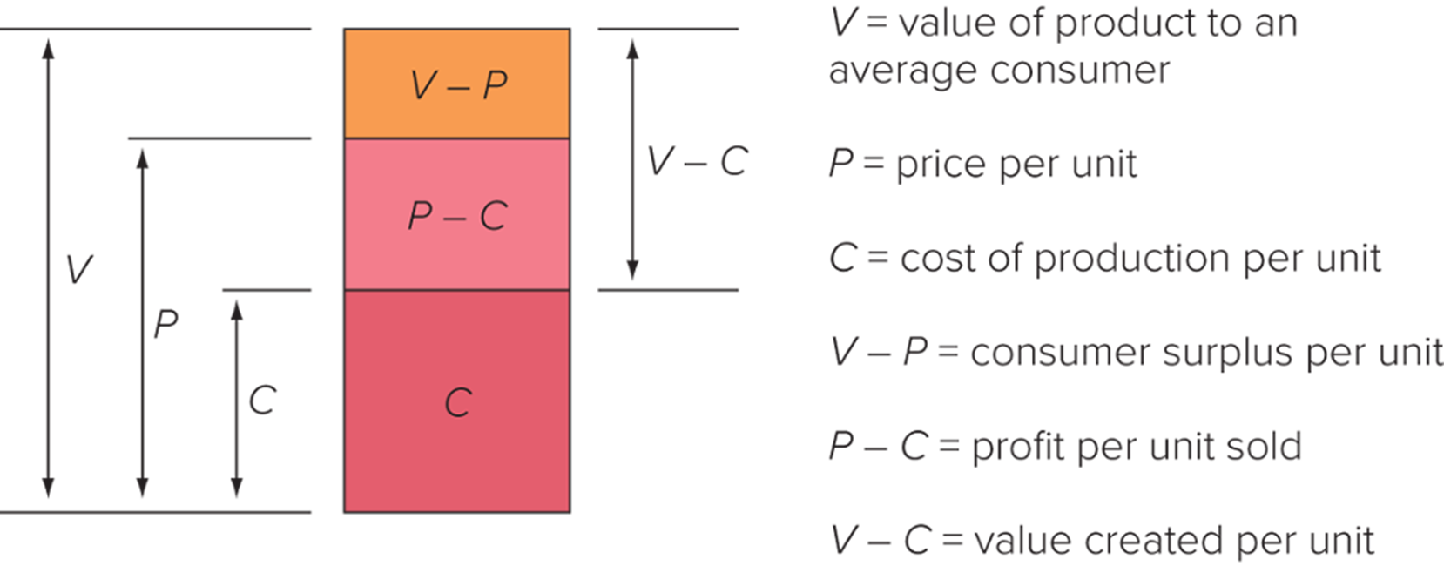
Figure 12.2 Value Creation
Access the text alternative for slide images.
Notes:
Figure 12.2 illustrates these concepts. The value of a product to an average consumer is V, the average price that the firm can charge a consumer for that product given competitive pressures and its ability to segment the market is P, and the average unit cost of producing that product is C (C comprises all relevant costs, including the firm’s cost of capital). The firm’s profit per unit sold (π) is equal to P − C, while the consumer surplus per unit is equal to V − P (another way of thinking of the consumer surplus is as “value for the money”; the greater the consumer surplus, the greater the value for the money the consumer gets). The firm makes a profit so long as P is greater than C, and its profit will be greater the lower C is relative to P.
The difference between V and P is in part determined by the intensity of competitive pressure in the marketplace: the lower the intensity of competitive pressure, the higher the price charged relative to V. In general, the higher the firm’s profit per unit sold is, the greater its profitability will be, all else being equal.

Slide 10
Strategy and the Firm 3
Strategic Positioning
Pick a position on the efficiency frontier that is viable—i.e., there is enough demand to support the choice.
Configure internal operations to support the position.
Have the right organization structure in place to execute the strategy.
Notes:
A firm’s strategy, operations, and organization must all be consistent with each other in order to achieve a competitive advantage and superior profitability.

Slide 11
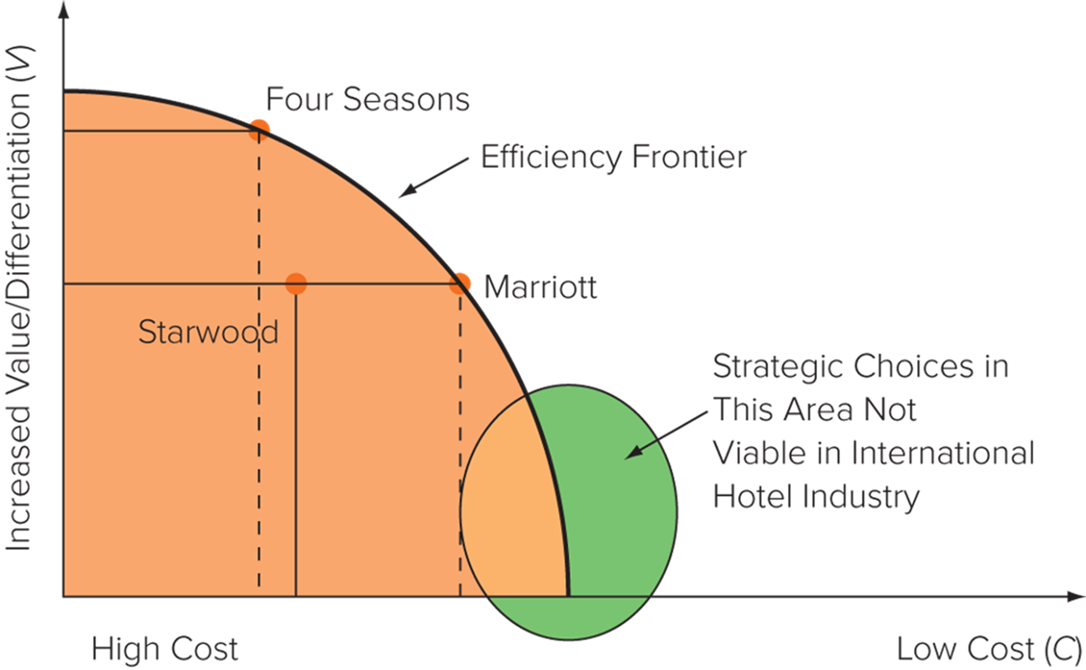
Figure 12.3 Strategic Choice in the International Hotel Industry
Access the text alternative for slide images.
Notes:
Figure 12.3 plots three hotel firms with a global presence that cater to international travelers: Canada’s Four Seasons, America’s Marriott International, and China’s JinJiang International, which owns a number of budget properties such as 7 Days Inns.
Porter notes that it is important for a firm to be explicit about its choice of strategic emphasis with regard to value creation (differentiation) and low cost and to configure its internal operations to support that strategic emphasis.
A central tenet of the basic strategy paradigm is that to maximize its profitability, a firm must do three things: (1) pick a position on the efficiency frontier that is viable in the sense that there is enough demand to support that choice; (2) configure its internal operations, such as manufacturing, marketing, logistics, information systems, human resources, and so on, so that they support that position; and (3) make sure that the firm has the right organization structure in place to execute its strategy. The strategy, operations, and organization of the firm must all be consistent with each other if it is to attain a competitive advantage and garner superior profitability.

Slide 12
Strategy and the Firm 4
Operations: The Firm as a Value Chain
Primary Activities.
The design, creation, and delivery of the product; its marketing; and its support and after-sale service.
Divided into research and development, production, marketing and sales, customer service.
Support Activities.
Provides the inputs that allow primary activities to occur.
Divided into information systems, company infrastructure, logistics, human resources.
Notes:
The operations of a firm can be thought of as a value chain composed of a series of distinct value creation activities, including production, marketing and sales, materials management, research and development, human resources, information systems, and the firm infrastructure.

Slide 13
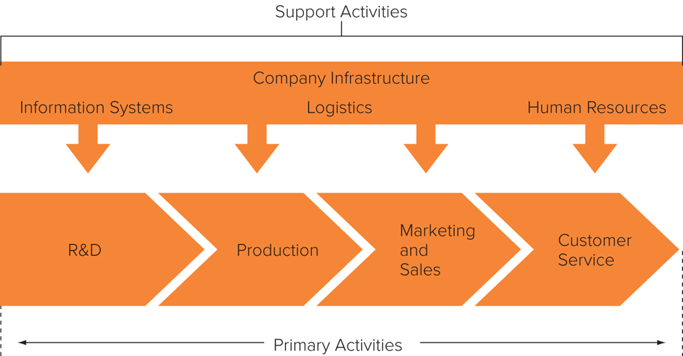
Figure 12.4 The Value Chain
Access the text alternative for slide images.
Notes:
Following normal practice, in the value chain illustrated in Figure 12.4, the primary activities are divided into four functions: research and development, production, marketing and sales, and customer service. The support activities of the value chain provide inputs that allow the primary activities to occur.

Slide 14
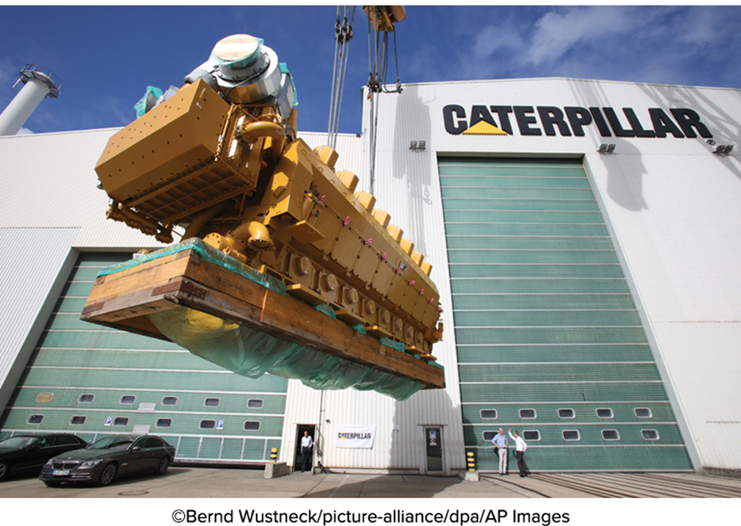
Operations Near and Far
A Caterpillar motor factory in Germany helps to ensure product after-sales and service outside the United States.
Wustneck/picture-alliance/dpa/A P Images

Slide 15
Strategy and the Firm 5
Organization: The Implementation of Strategy
Organization architecture: the totality of a firm’s organization, including the formal organizational structure, control systems and incentives, organizational culture, processes, and people.
Organizational structure:
The formal division of the organization into subunits.
The location of decision-making responsibilities within that structure.
The establishment of integrating mechanisms to coordinate the activities of subunits including cross-functional teams and or pan-regional committees.
Notes:
The strategy of a firm is implemented through its organization. For a firm to have superior return on invested capital (ROIC), its organization must support its strategy and operations.

Slide 16
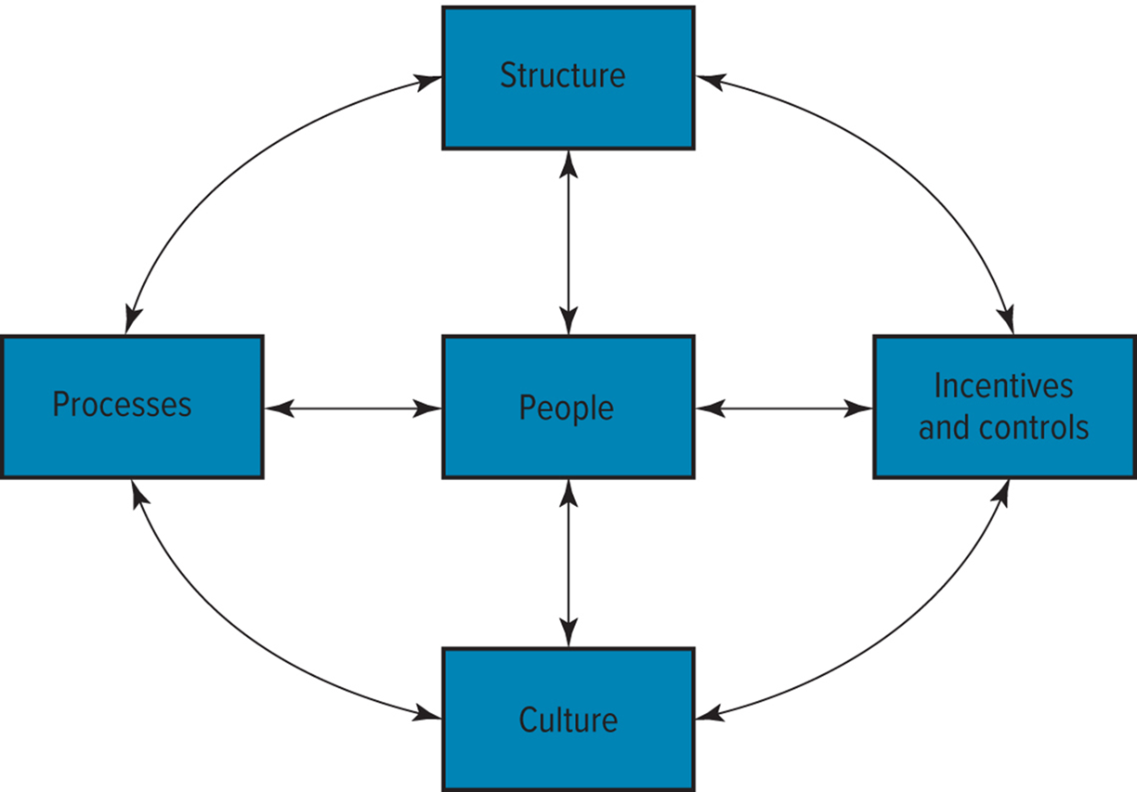
Figure 12.5 Organization Architecture
Notes:
As illustrated by the arrows, the various components of an organization’s architecture are not independent of each other: Each component shapes, and is shaped by, other components of architecture.

Slide 17
Strategy and the Firm 6
Organization: The Implementation of Strategy continued
Controls: metrics used to measure the performance of subunits and make judgments about how well the subunits are run.
Incentives: devices used to reward appropriate managerial behavior.
Processes: manner in which decisions are made and work is performed.
Organizational culture: norms and value systems that are shared among the employees.
People: employees and the strategy used to recruit, compensate, and retain those individuals.
Notes:
If a firm is going to maximize its profitability, it must pay close attention to achieving internal consistency among the various components of its architecture, and the architecture must support the strategy and operations of the firm.

Slide 18
Strategy and the Firm 7
Strategic Fit
The operations of the firm must support the firm’s strategy.
The organizational architecture of the firm must match the firm’s operations and strategy.
If market conditions shift, so must the firm’s strategy, operations, and organization.
Notes:
In other words, as illustrated in Figure 12.6 (see next slide), market conditions, strategy, operations, and organization must all be consistent with each other, or fit each other, for superior performance to be attained.

Slide 19
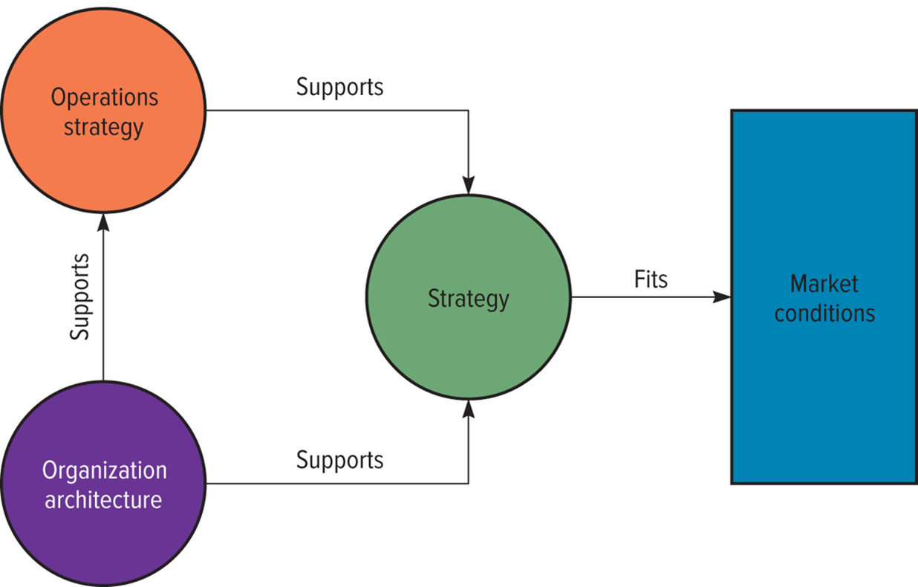
Figure 12.6 Strategic Fit
Notes:
The issue is more complex than illustrated in Figure 12.6. For example, the firm can influence market conditions through its choice of strategy—it can create demand by leveraging core skills to create new market opportunities.

Slide 20
Global Expansion, Profitability, and Profit Growth 1
Firms That Operate Internationally
Expand the market for their domestic product offerings by selling their products in international markets.
Realize location economies by dispersing individual value creation activities to locations around the globe where they can be performed most efficiently and effectively.
Realize greater cost economies from experience effects by serving an expanded global market from a central location, reducing the costs of value creation.
Earn a greater return by leveraging any valuable skills developed in foreign operations and transferring them to other entities within the firm’s global network of operations.
Notes:
LO 12-2 Recognize how firms can increase revenue and profit by expanding globally.
Expanding globally allows firms to increase their profitability and rate of profit growth in ways not available to purely domestic enterprises.

Slide 21
Global Expansion, Profitability, and Profit Growth 2
Expanding the Market: Leveraging Products and Competencies
To increase growth, a firm can sell products or services developed at home in foreign markets.
Success depends on the type of goods and services and the firm’s core competence—the skills within the firm that competitors cannot easily match or imitate.
Enable firm to reduce costs of value creation.
Create perceived value so premium pricing is possible.
Are the source of a firm’s competitive advantage.
Notes:
Core competence refers to skills within the firm that competitors cannot easily match or imitate. These skills may exist in any of the firm’s value creation activities: production, marketing, R&D, human resources, logistics, general management, and so on.
Toyota has a core competence in the production of cars.
IKEA has a core competence in the design of stylish and affordable furniture.
McDonald’s has a core competence in managing fast-food operations.
Procter & Gamble (P&G) has a core competence in developing and marketing name-brand consumer products.

Slide 22
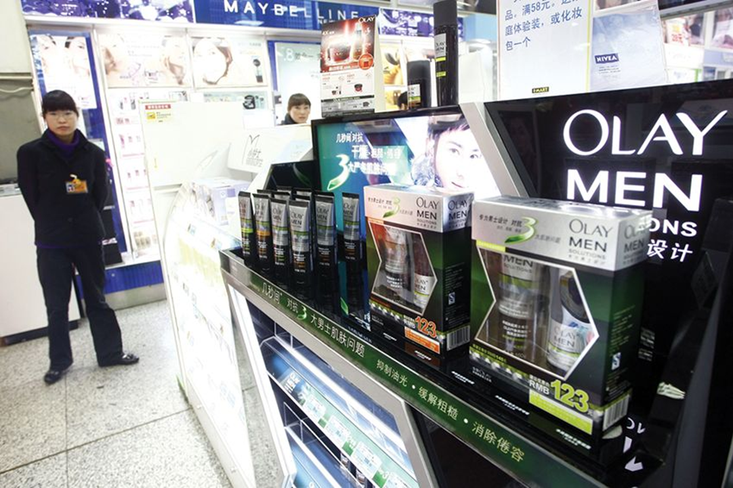
Core Competency
P&G’s core competency in marketing is evidenced in this photo of Olay men’s skin care products for sale in a Shanghai, China, supermarket.
Weng lie/Imaginechina/A P Images

Slide 23
Global Expansion, Profitability, and Profit Growth 3
Location Economies
Firms should locate value creation activities where economic, political, and cultural conditions are most conducive to performance of that activity.
Results in location economies: cost advantages that arise from performing a value creation activity in the optimal location for that activity, wherever in the world that might be.
Locating value creation activities in optimal locations:
Can lower the costs of value creation.
Can enable a firm to differentiate its product offering from those of competitors.
Notes:
Locating a value creation activity in the optimal location for that activity can have one of two effects. It can lower the costs of value creation and help the firm to achieve a low-cost position, and/or it can enable a firm to differentiate its product offering from those of competitors. In terms of Figure 12.2 (see slide 9), it can lower C and/or increase V (which, in general, supports higher pricing), both of which boost the profitability of the enterprise.

Slide 24
Global Expansion, Profitability, and Profit Growth 4
Creating a Global Web
Multinationals that take advantage of location economies create a global web of value creation activities.
Different stages of the value chain are dispersed to those locations around the globe where perceived value is maximized or where the costs of value creation are minimized.
Some Caveats
Introducing transportation costs and trade barriers complicates it.
Political and economic risks must be assessed when making location decisions.
Notes:
In theory, a firm that realizes location economies by dispersing each of its value creation activities to its optimal location should have a competitive advantage vis-à-vis a firm that bases all of its value creation activities at a single location. It should be able to better differentiate its product offering (thereby raising perceived value, V) and lower its cost structure (C) than its single-location competitor.

Slide 25
Global Expansion, Profitability, and Profit Growth 5
Experience Effects
Experience curve: systematic reductions in production costs that occur over the life of a product.
A product’s production costs decline by some quantity about each time cumulative output doubles.
Learning Effects.
Cost savings that come from learning by doing.
Labor productivity increases when individuals learn the most efficient ways to perform particular tasks and management learns how to manage the new operation more efficiently.
Notes:
Learning effects tend to be more significant when a technologically complex task is repeated because there is more that can be learned about the task. Thus, learning effects will be more significant in an assembly process involving 1,000 complex steps than in one of only 100 simple steps.

Slide 26
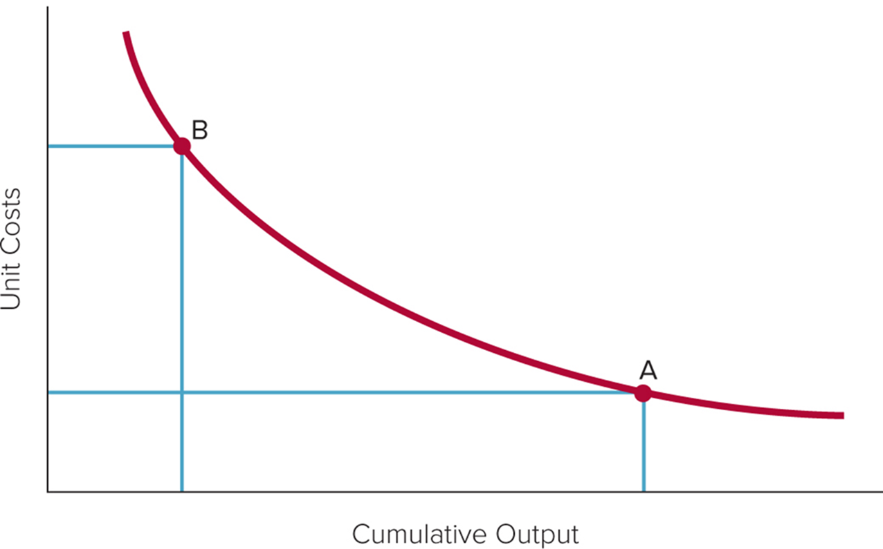
Figure 12.7 The Experience Curve
Access the text alternative for slide images.
Notes:
Figure 12.7 illustrates this experience curve relationship between unit production costs and cumulative output (the relationship is for cumulative output over time and not output in any one period, such as a year). Two things explain this: learning effects and economies of scale.

Slide 27
Global Expansion, Profitability, and Profit Growth 6
Experience Effects continued
Economies of Scale.
Reductions in unit cost achieved by producing a large volume of a product.
Ability to spread fixed costs over a large volume but unable to attain efficient scale of production unless serving global markets.
Bargaining power increases with suppliers, which may allow economies of scale in purchasing.
Strategic Significance.
Moving down experience curve allows firm to reduce its cost of creating value and increase its profitability.
Once firm has established low-cost position, it can act as a barrier to new competition.
Notes:
Many of the underlying sources of experience-based cost economies are plant-based. This is true for most learning effects as well as for the economies of scale derived by spreading the fixed costs of building productive capacity over a large output, attaining an efficient scale of output, and utilizing a plant more intensively.

Slide 28
Global Expansion, Profitability, and Profit Growth 7
Leveraging Subsidiary Skills
Recognize that valuable skills can be developed anywhere within the firm’s global network (not just at the corporate center).
Use incentive systems to encourage local employees to acquire new skills.
Develop a process to identify when new skills have been created.
Act as facilitators to transfer valuable skills within the firm.
Notes:
Valuable skills are developed first at home and then transferred to foreign operations. However, for more mature multinationals that have already established a network of subsidiary operations in foreign markets, the development of valuable skills can just as well occur in foreign subsidiaries.
Managers of multinational enterprises face new challenges. First, they must have the humility to recognize that valuable skills that lead to competencies can arise anywhere within the firm’s global network, not just at the corporate center. Second, they must establish an incentive system that encourages local employees to acquire new skills.

Slide 29
Global Expansion, Profitability, and Profit Growth 8
Profitability and Profit Growth Summary
Firms that expand internationally can increase profitability and profit growth by:
Entering markets where competitors lack similar competencies.
Realizing location economies.
Exploiting experience curve effects.
Transferring valuable skills within the organization.
Notes:
It should be noted that strategies that increase profitability may also expand a firm’s business and thus enable it to attain a higher rate of profit growth.

Slide 30
Cost Pressures and Pressures for Local Responsiveness 1
Pressures for Cost Reductions
Strong in industries producing commodity-type products that fill universal needs: needs that exist when tastes and preferences of consumers in different nations are similar if not identical.
When major competitors are based in low-cost locations.
Where there is persistent excess capacity.
Where consumers are powerful and face low switching costs.
Notes:
LO 12-3 Understand how pressures for cost reductions and local responsiveness influence strategic choice.
In competitive global markets, international businesses often face pressures for cost reductions. Responding to pressures for cost reduction requires a firm to try to lower the costs of value creation. A manufacturer, for example, might mass-produce a standardized product at the optimal locations in the world, wherever that might be, to realize economies of scale, learning effects, and location economies. Alternatively, a firm might outsource certain functions to low-cost foreign suppliers in an attempt to reduce costs.

Slide 31
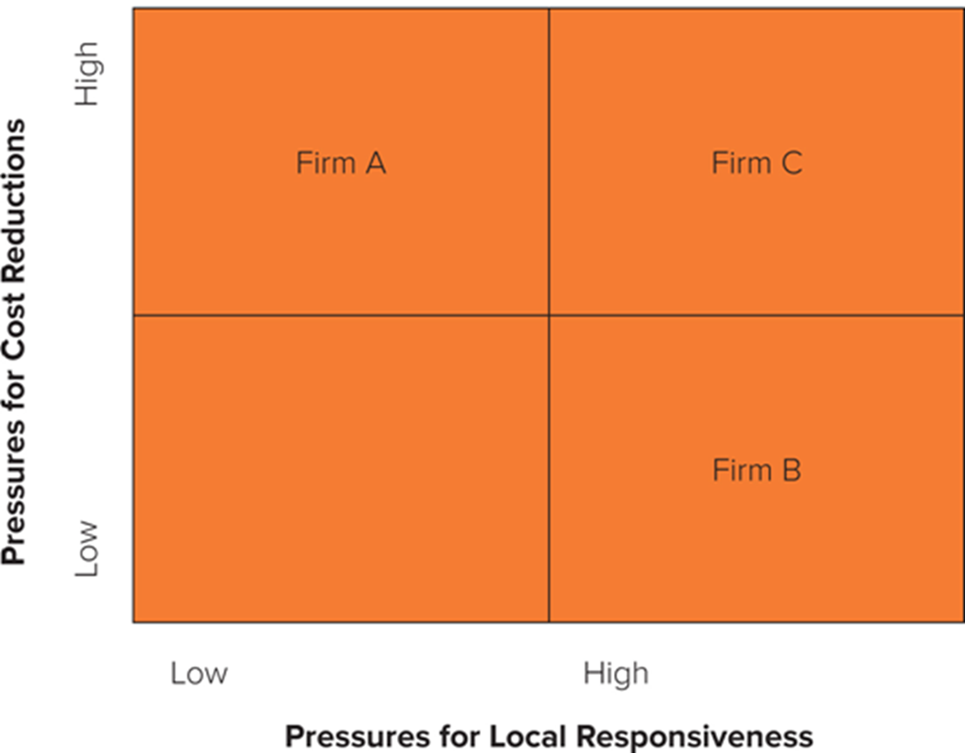
Figure 12.8 Pressures for Cost Reductions and Local Responsiveness
Access the text alternative for slide images.
Notes:
While some enterprises, such as firm A in Figure 12.8, face high pressures for cost reductions and low pressures for local responsiveness, and others, such as firm B, face low pressures for cost reductions and high pressures for local responsiveness, many companies are in the position of firm C. They face high pressures for both cost reductions and local responsiveness. Dealing with these conflicting and contradictory pressures is a difficult strategic challenge, primarily because being locally responsive tends to raise costs.

Slide 32
Cost Pressures and Pressures for Local Responsiveness 2
Pressures for Local Responsiveness
Differences in consumer tastes and preferences.
Differences in infrastructure and traditional practices.
Differences in distribution channels.
Host-government demands.
The rise of regionalism.
Firms facing these pressures need to differentiate their products and marketing strategies in each country.

Slide 33
Cost Pressures and Pressures for Local Responsiveness 3
Differences in Consumer Tastes and Preferences
When consumer tastes and preferences differ significantly between countries, firms face strong pressures for local responsiveness.
Automobile industry.
Differences in Infrastructure and Traditional Practices
When there are differences in infrastructure and/or traditional practices, there is need to customize products.
Consumer electrical systems.
Notes:
Strong pressures for local responsiveness emerge when customer tastes and preferences differ significantly among countries, as they often do for deeply embedded historic or cultural reasons.
Pressures for local responsiveness arise from differences in infrastructure or traditional practices among countries, creating a need to customize products accordingly. Fulfilling this need may require the delegation of manufacturing and production functions to foreign subsidiaries.

Slide 34
Cost Pressures and Pressures for Local Responsiveness 4
Differences in Distribution Channels
A firm’s marketing strategies may be influenced by differences in distribution channels between countries, which may necessitate delegation of marketing functions to national subsidiaries.
Pharmaceutical industry.
Host-Government Demands
Economic and political demands imposed by host-country governments may necessitate a degree of local responsiveness.
Railcars.
Notes:
In the pharmaceutical industry, for example, the British and Japanese distribution systems are radically different from the U.S. system. British and Japanese doctors will not accept or respond favorably to a U.S.-style high-pressure sales force. Thus, pharmaceutical companies have to adopt different marketing practices in Britain and Japan compared with the United States—soft sell versus hard sell.
More generally, threats of protectionism, economic nationalism, and local content rules (which require that a certain percentage of a product should be manufactured locally) dictate that international businesses manufacture locally.

Slide 35
Cost Pressures and Pressures for Local Responsiveness 5
The Rise of Regionalism
Regional convergence of tastes and preferences can influence product offerings within a bloc of nations.
European Union and the euro zone.
North America: N A F T A and U S M C A.
Latin America.
Greater China, Hong Kong, and Singapore.
Middle East.
Russia and former Soviet states.
Notes:
Taking a regional perspective is important because it may suggest that localization at the regional rather than the national level is the appropriate strategic response.

Slide 36
Choosing a Strategy 1
Four Basic Strategies in Global Markets
Global standardization.
Localization.
Transnational.
International.
Notes:
LO 12-4 Identify the different international strategies for competing and their pros and cons.
How do differences in the strength of pressures for cost reductions versus those for local responsiveness affect a firm’s choice of strategy? Firms typically choose among four main strategic postures when competing internationally. These can be characterized as a global standardization strategy, a localization strategy, a transnational strategy, and an international strategy.

Slide 37
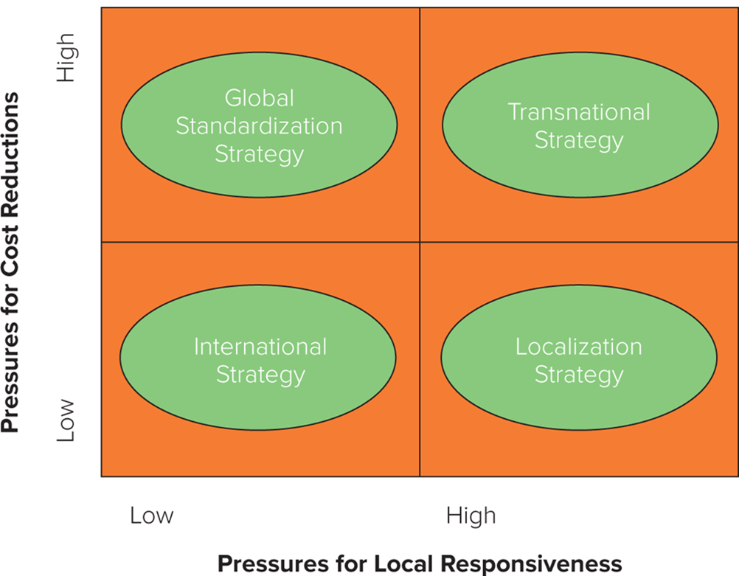
Figure 12.9 Four Basic Strategies
Access the text alternative for slide images.
Notes:
The appropriateness of each strategy varies, given the extent of pressures for cost reductions and local responsiveness. Figure 12.9 illustrates the conditions under which each of these strategies is most appropriate.

Slide 38
Choosing a Strategy 2
Global Standardization Strategy
Focuses on increasing profitability and profit growth by reaping the cost reductions that come from economies of scale, learning effects, and location economies.
Goal is to pursue a low-cost strategy on a global scale.
Makes sense when there are strong pressures for cost reductions and demands for local responsiveness are minimal.
Notes:
This strategy makes most sense when there are strong pressures for cost reductions and demands for local responsiveness are minimal. Increasingly, these conditions prevail in many industrial goods industries, whose products often serve universal needs. In the semiconductor industry, for example, global standards have emerged, creating enormous demands for standardized global products. Accordingly, companies such as Intel, Texas Instruments, and Motorola all pursue a global standardization strategy.

Slide 39
Choosing a Strategy 3
Localization Strategy
Focuses on increasing profitability by customizing the firm’s goods or services to match the tastes and preferences in different national markets.
Makes sense when there are substantial differences across nations with regard to consumer tastes and preferences, and where cost pressures are not too intense.
Notes:
Firms pursuing a localization strategy still need to be efficient and, whenever possible, to capture some scale economies from their global reach. As noted earlier, many automobile companies have found that they have to customize some of their product offerings to local market demands—for example, producing large pickup trucks for North American consumers and small fuel-efficient cars for Europeans and Japanese.

Slide 40
Choosing a Strategy 4
Transnational Strategy
Firm simultaneously faces both strong cost pressures and strong pressures for local responsiveness.
Attempts to simultaneously:
Achieve low costs through location economies, economies of scale, and learning effects.
Differentiate the product offering across geographic markets to account for local differences.
Foster a multidirectional flow of skills between different subsidiaries.
Implementing an effective transnational strategy is complex.
Notes:
Differentiating the product to respond to local demands in different geographic markets raises costs, which runs counter to the goal of reducing costs. Companies such as 3M and ABB (a Swiss-Swedish multinational engineering conglomerates) have tried to embrace a transnational strategy and found it difficult to implement.

Slide 41
Choosing a Strategy 5
International Strategy
Involves taking products first produced for the domestic market and then selling them internationally with only minimal local customization.
Makes sense when there are low cost pressures and low pressures for local responsiveness.
Notes:
Enterprises pursuing an international strategy have followed a similar developmental pattern as they expanded into foreign markets. They tend to centralize product development functions such as R&D at home. However, they also tend to establish manufacturing and marketing functions in each major country or geographic region in which they do business. Firms that have pursued this strategy include Procter & Gamble and Microsoft.

Slide 42
Choosing a Strategy 6
The Evolution of Strategy
As competition increases, international and localization strategies become less viable.
To survive, firms may need to shift to a global standardization strategy or a transnational strategy in advance of competitors.
Notes:
The Achilles’ heel of the international strategy is that over time, competitors inevitably emerge, and if managers do not take proactive steps to reduce their firm’s cost structure, it will be rapidly outflanked by efficient global competitors. This is what happened to Xerox.

Slide 43
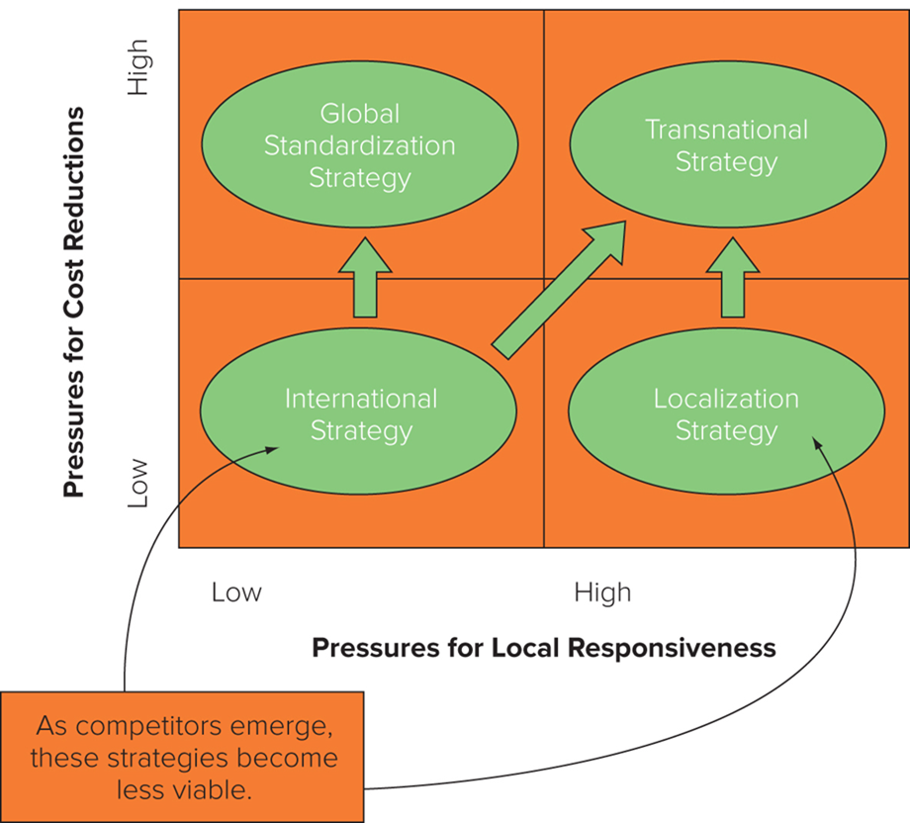
Figure 12.10 Changes in Strategy over Time
Access the text alternative for slide images.
Notes:
The message in this story is that an international strategy may not be viable in the long term and to survive, firms need to shift toward a global standardization strategy or a transnational strategy in advance of competitors (see Figure 12.10).

Slide 44
Strategic Alliances 1
Strategic Alliances
Cooperative agreements between potential or actual competitors.
Examples include formal joint ventures and short-term contractual arrangements.
The number of international strategic alliances has risen significantly in recent decades.
Notes:
LO 12-5 Explain the pros and cons of using strategic alliances to support international strategies.

Slide 45
Strategic Alliances 2
The Advantages of Strategic Alliances
Facilitate entry into a foreign market.
Allow firms to share the fixed costs and risks of developing new products or processes.
Bring together complementary skills and assets that neither partner could easily develop on its own.
Can help establish technological standards for the industry that will benefit the firm.

Slide 46

A Strategic Alliance
Canadian actor Chris Collins, actress Jacky Cai, and actress Hanna Chan arrive at the red carpet of the premiere of film Paradox on August 14, 2017, in Beijing, China. The strategic alliance between Warner Brothers and its Chinese partners has helped streamline the process for film distribution.
V C G/V C G/Getty Images

Slide 47
Strategic Alliances 3
The Disadvantages of Strategic Alliances
Can give competitors low-cost routes to new technology and markets.
Can give away more in a strategic alliance than it receives.
Notes:
Critics have a point; alliances have risks. Unless a firm is careful, it can give away more than it receives. But there are so many examples of apparently successful alliances between firms—including alliances between U.S. and Japanese firms—that the critics’ position seems extreme.

Slide 48
Strategic Alliances 4
Making Alliances Work
Partner Selection.
Collect as much information as possible.
Gather data from informed third parties.
Get to know the potential partner well before committing.
Alliance Structure.
Can be designed to make it difficult to transfer technology not meant to be transferred.
Can write contractual safeguards into alliance agreement to guard against risk of opportunism.
Both parties can agree in advance to swap skills and technologies that the other covets.
Notes:
A good ally, or partner, has three characteristics.
First, a good partner helps the firm achieve its strategic goals, whether they are market access, sharing the costs and risks of product development, or gaining access to critical core competencies. The partner must have capabilities that the firm lacks and that it values.
Second, a good partner shares the firm’s vision for the purpose of the alliance. If two firms approach an alliance with radically different agendas, the chances are great that the relationship will not be harmonious, will not flourish, and will end in divorce.
Third, a good partner is unlikely to try to opportunistically exploit the alliance for its own ends, that is, to expropriate the firm’s technological know-how while giving away little in return. In this respect, firms with reputations for “fair play” probably make the best allies.

Slide 49
Strategic Alliances 5
Making Alliances Work continued
Managing the Alliance.
Requires managers from both companies to build interpersonal relationships (relational capital).
Should promote learning from alliance partners.
Should promote the diffusion of learned knowledge throughout the organization.
Notes:
Once a partner has been selected and an appropriate alliance structure has been agreed on, the task facing the firm is to maximize its benefits from the alliance. As in all international business deals, an important factor is sensitivity to cultural differences.

Slide 50
360° View: Impact of the Macro Environment 1
Cross Border Trade, Investment and Strategy
Change in the rules governing international trade and investment can affect the viability of different strategies.
Trend was toward lowering of barriers to cross-border trade and investment.
Recent reversal of this trend under Trump administration.
Trade barriers/trade war between U.S. and China have impacted world economy.
If economic nationalism continues to increase, localization strategy may become more viable and necessary.
Regionalization may also increase.
Notes:
Another point to keep in mind is that so far, the trade conflicts between the United States and its trading partners have primarily been focused on trade in goods, not services, and have not explicitly limited cross-border investments. If these conflicts extended to encompass services and cross-border investments, the case for a localization or multiregional strategy will be strengthened.

Slide 51
360° View: Impact of the Macro Environment 2
Exogenous Shocks and Strategy
War, terrorism, climate change, and emergence of novel disease can easily change trade and investment environment and affect strategic choices.
Global supply chains are vulnerable to disruption.
Dislocating events increase the attractiveness of location strategies.
Notes:
Consider the emergence in 2020 of a global pandemic resulting from the spread of the severe acute respiratory syndrome coronavirus 2 (SARS-CoV-2), which causes the COVID-19 disease (COVID stands for CoronaVirus Disease 19). The rising number of infections and deaths around the world due to COVID-19 has not only caused severe economic dislocation worldwide, depressing demand in many nations, but has also disrupted global supply chains and led many to question the value of building a globally dispersed web of productive activities to support a global standardization strategy.

Slide 52
Summary
In this chapter, we have
Explained the concept of international business strategy.
Recognized how firms can increase revenue and profit by expanding globally.
Understood how pressures for cost reductions and local responsiveness influence strategic choice.
Identified the different international strategies for competing and their pros and cons.
Explained the pros and cons of using strategic alliances to support international strategies.

Slide 53
End of Main Content
© 2022 McGraw Hill. All rights reserved. Authorized only for instructor use in the classroom. No reproduction or further distribution permitted without the prior written consent of McGraw Hill.

Slide 54
Accessibility Content: Text Alternatives for Images

Slide 55
Figure 12.1 Determinants of Enterprise Value – Text Alternative
Return to parent-slide containing images.
Enterprise valuation leads to two branches, profitability and profit growth. Profitability leads to reduced costs and added value and raised prices. Profit growth leads to selling more in existing markets and entering new markets.
Return to parent-slide containing images.

Slide 56
Figure 12.2 Value Creation – Text Alternative
Return to parent-slide containing images.
V equals value of product to an average consumer. P equals price per unit. C equals cost of production per unit. V minus P equals consumer surplus per unit. P minus C equals profit per unit sold. V minus C equals value created per unit.
Return to parent-slide containing images.

Slide 57
Figure 12.3 Strategic Choice in the International Hotel Industry – Text Alternative
Return to parent-slide containing images.
The vertical axis is labeled increased value or Differentiation and horizontal axis is labeled cost and ranges from high to low. The graph shows a convex curve which falls from the vertical axis to the horizontal axis. The boundary of the curve is labeled efficiency frontier. Four Seasons and Marriott are marked on the efficiency frontier, Four Season at the beginning of the curve and Marriot towards the center. Starwood is marked inside the frontier. a circle encompasses the rightmost region around the efficiency frontier. A note for this region reads: Strategic Choices in This Area Not Viable in International Hotel Industry.
Return to parent-slide containing images.

Slide 58
Figure 12.4 The Value Chain – Text Alternative
Return to parent-slide containing images.
The supply chain is composed of primary and support activities. Support activities include the company infrastructure, which is made up of information systems, logistics, and human resources. Primary activities include R and D, production, marketing and sales, and customer service.
Return to parent-slide containing images.

Slide 59
Figure 12.7 The Experience Curve – Text Alternative
Return to parent-slide containing images.
The vertical axis has Unit Costs. The horizontal axis has Cumulative output. A curve from the top left goes past a point marked B high on unit costs and low on cumulative output down to the right to a point marked A high on cumulative output and low on unit costs.
Return to parent-slide containing images.

Slide 60
Figure 12.8 Pressures for Cost Reductions and Local Responsiveness – Text Alternative
Return to parent-slide containing images.
Pressures for cost reductions and pressures for local responsiveness range from low to high. High Pressures for cost reductions and low pressures for local responsiveness: Firm A. High Pressures for cost reductions and high pressures for local responsiveness: Firm C. Low Pressures for cost reductions and high pressures for local responsiveness: Firm B. Low Pressures for cost reductions and low pressures for local responsiveness: blank.
Return to parent-slide containing images.

Slide 61
Figure 12.9 Four Basic Strategies – Text Alternative
Return to parent-slide containing images.
High pressure for cost reductions and low pressure for local responsiveness: Global Standardization Strategy.
High pressure for cost reductions and high pressure for local responsiveness: Transnational Strategy.
Low pressure for cost reductions and low pressure for local responsiveness: International Strategy.
Low pressure for cost reductions and high pressure for local responsiveness: Localization Strategy.
Return to parent-slide containing images.

Slide 62
Figure 12.10 Changes in Strategy over Time – Text Alternative
Return to parent-slide containing images.
International and localization strategies become less viable as competitors emerge.
When competitors emerge a company might want to shift from an international strategy to a global standardization strategy or transnational strategy.
If the company has a localization strategy and competitors emerge, the company might want to shift to a transnational strategy.
Return to parent-slide containing images.

